Slide 1
Conflict and Regime Type in Africa
Sam Kane Jiménez
Professor Seay
GO455: Conflict and Crisis in Africa
5 May 2020

Slide 2
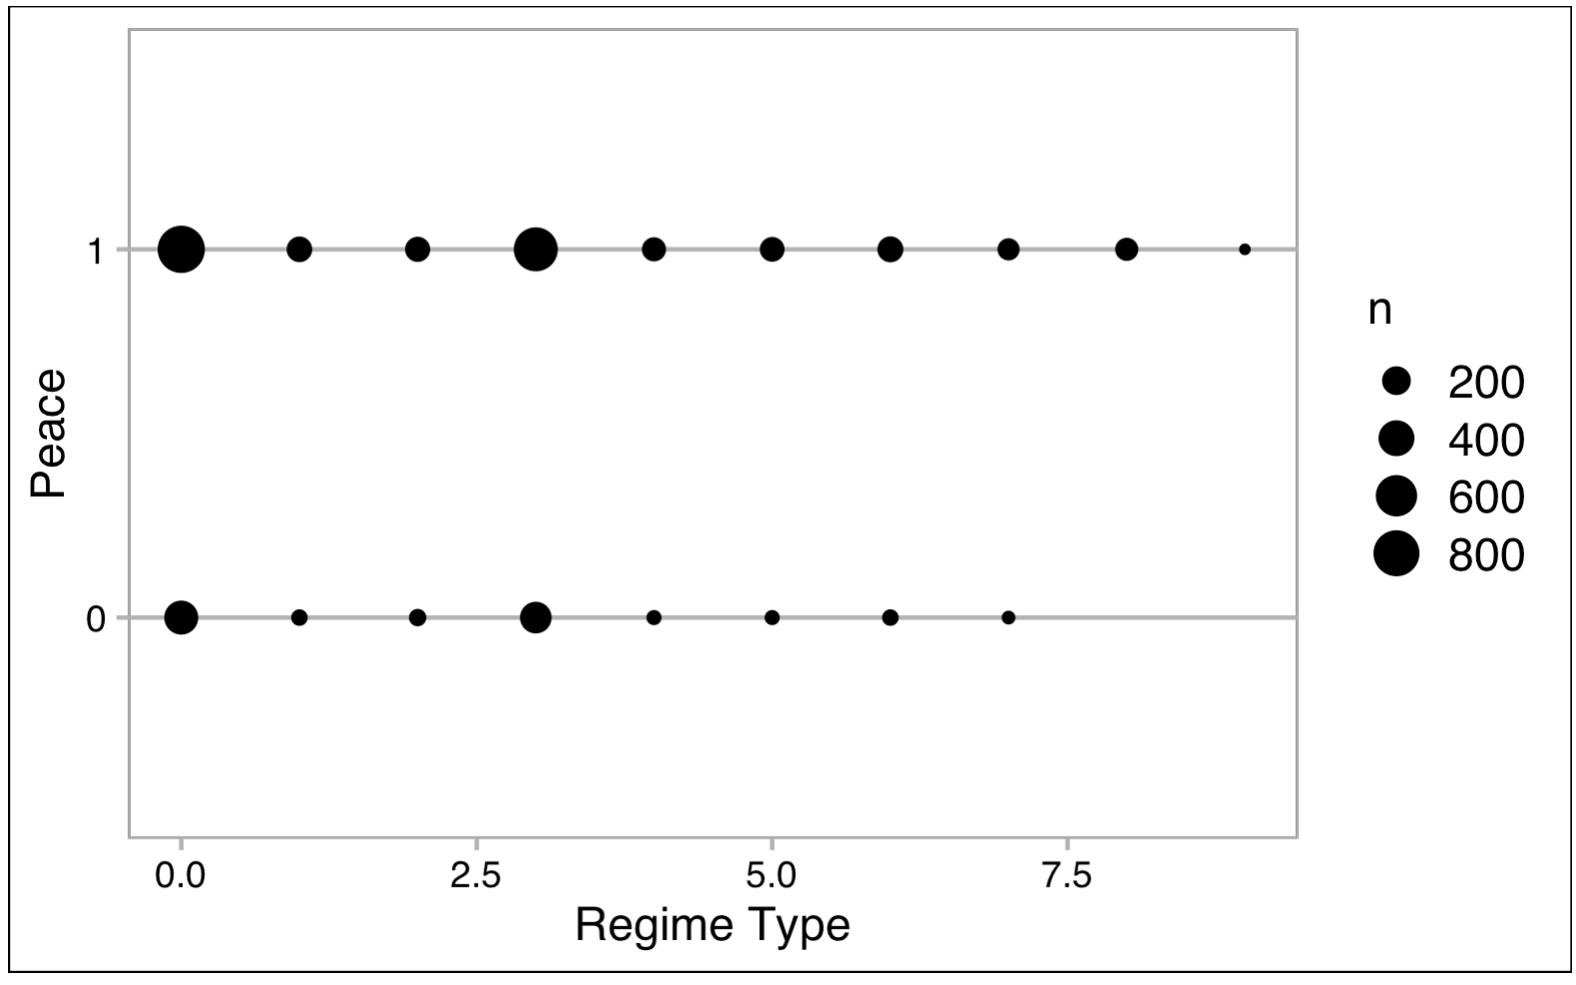
Is there a causal association between regime type and level of intrastate violence and, if so, in which direction and to what degree?
Driving Research Question

Slide 3
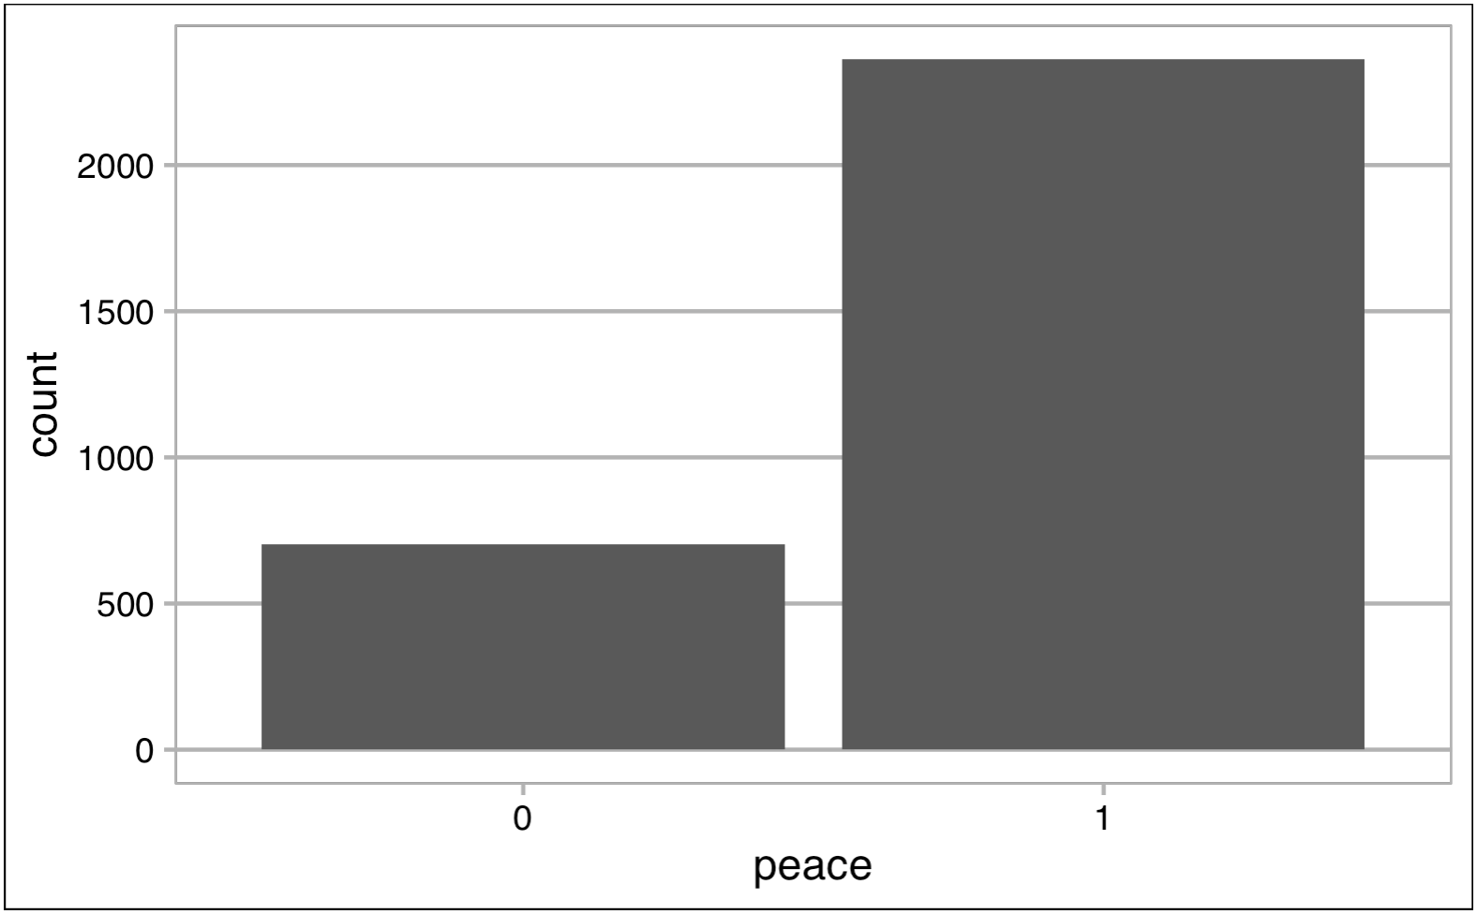
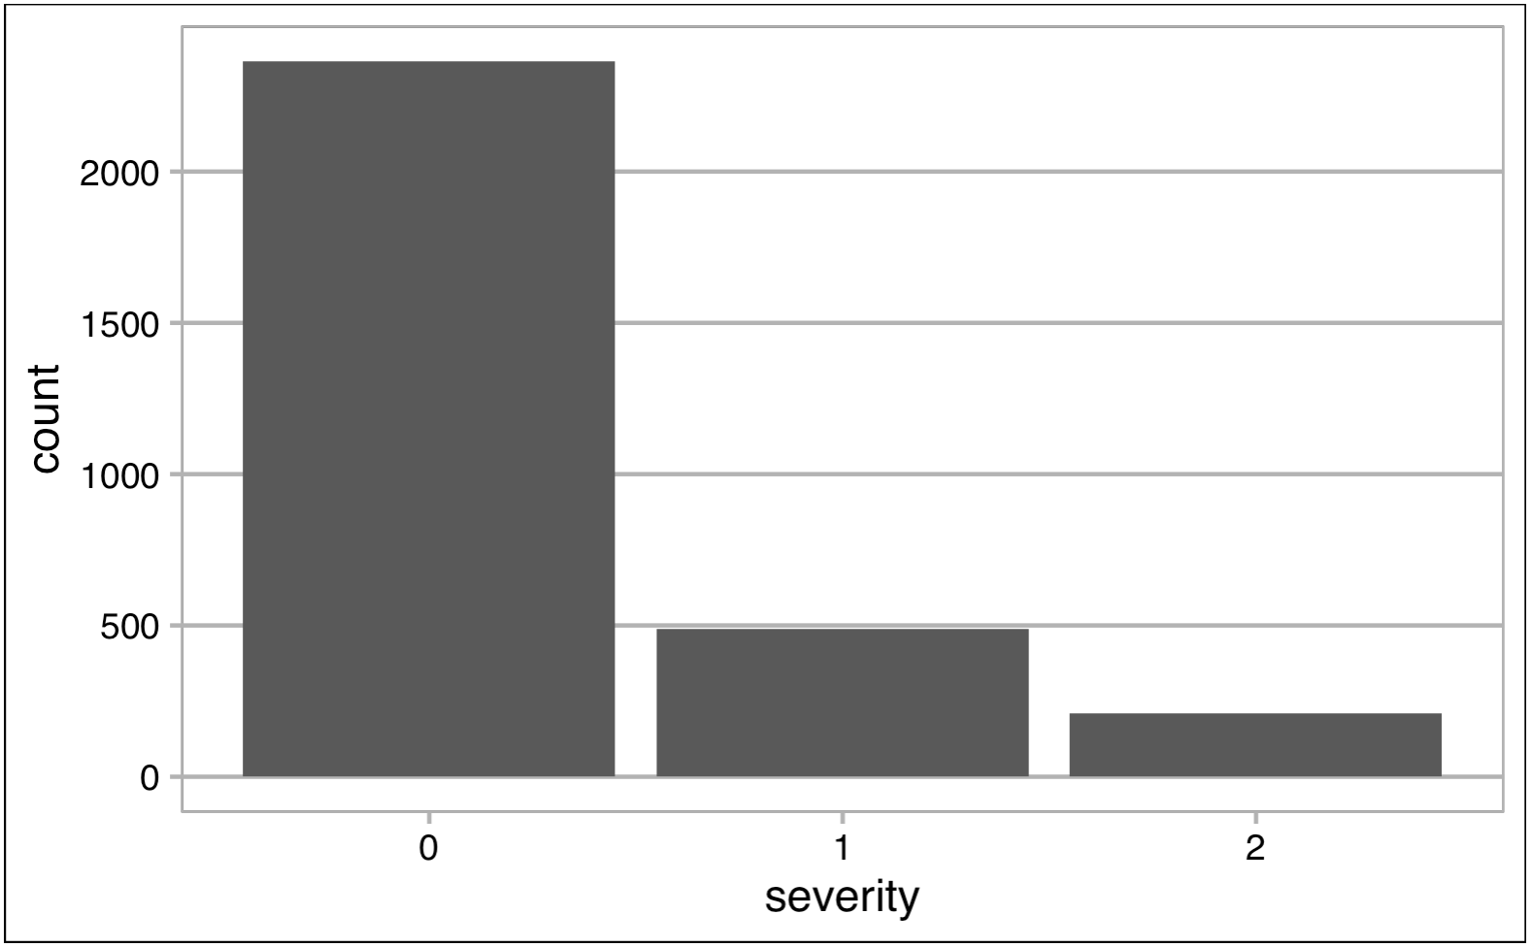
Operationalizing Central Variables
Conflict
Peace
Severity
Duration
Relapse
Regime Type
Continuous
Ordinal
Regime Change

Slide 4
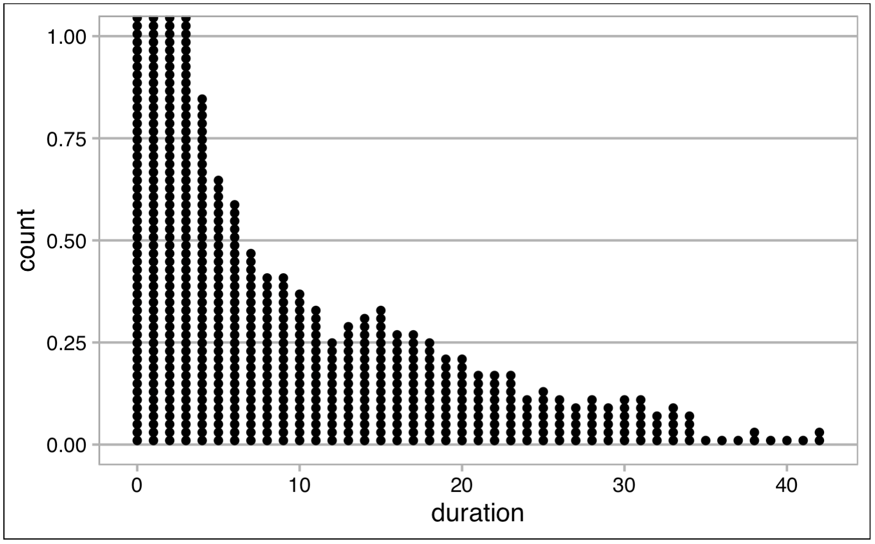
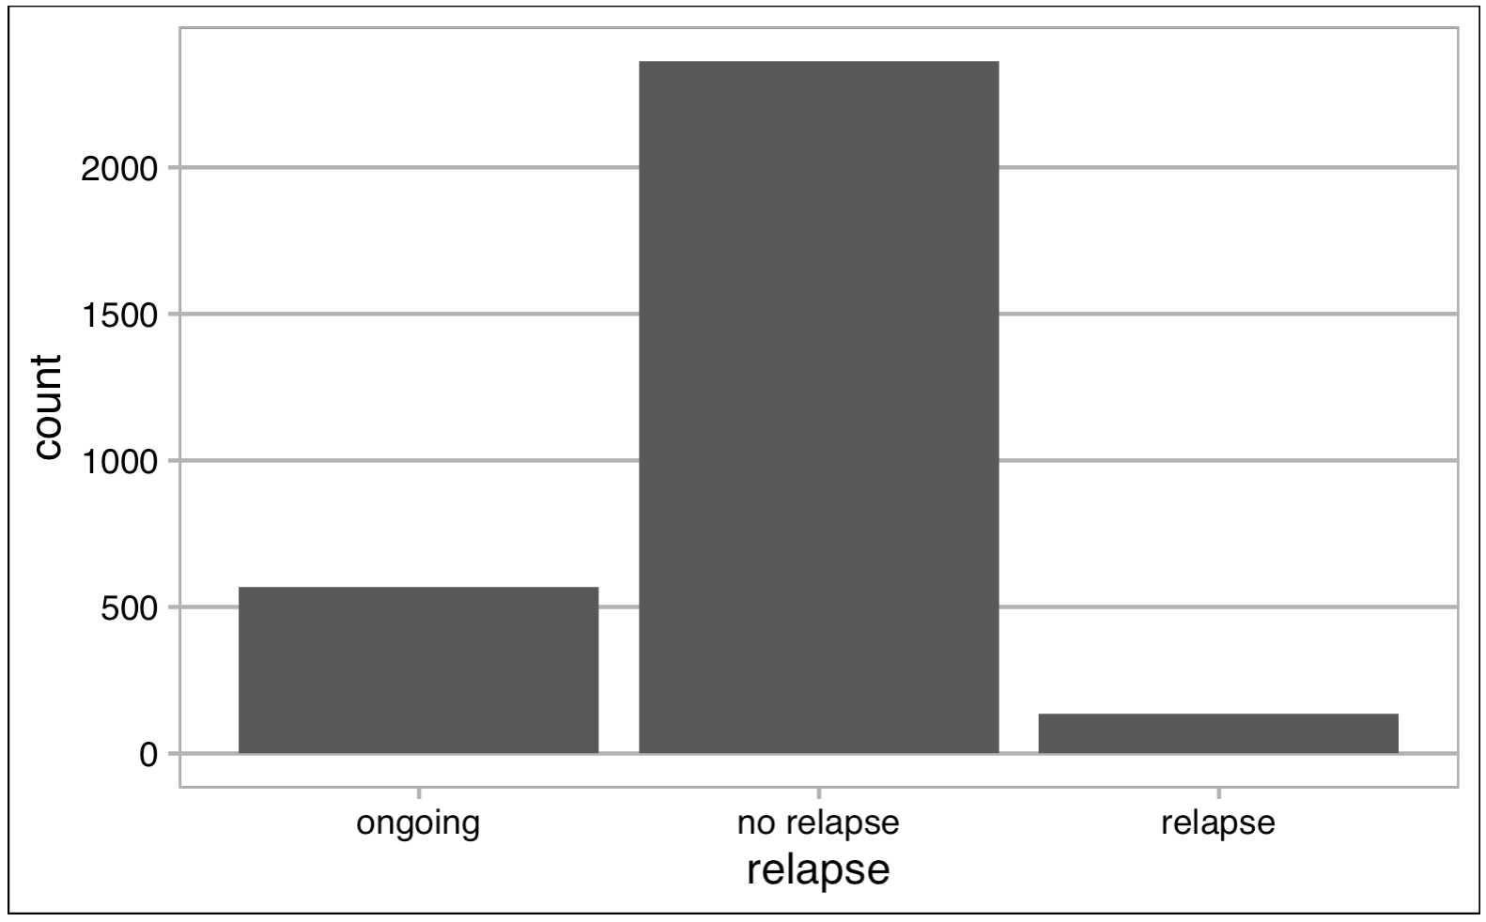
Operationalizing Central Variables
Conflict
Peace
Severity
Duration
Relapse
Regime Type
Continuous
Ordinal
Regime Change

Slide 5
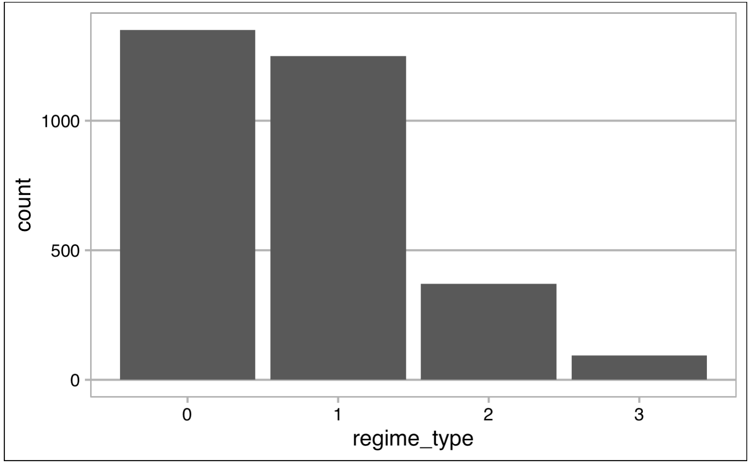
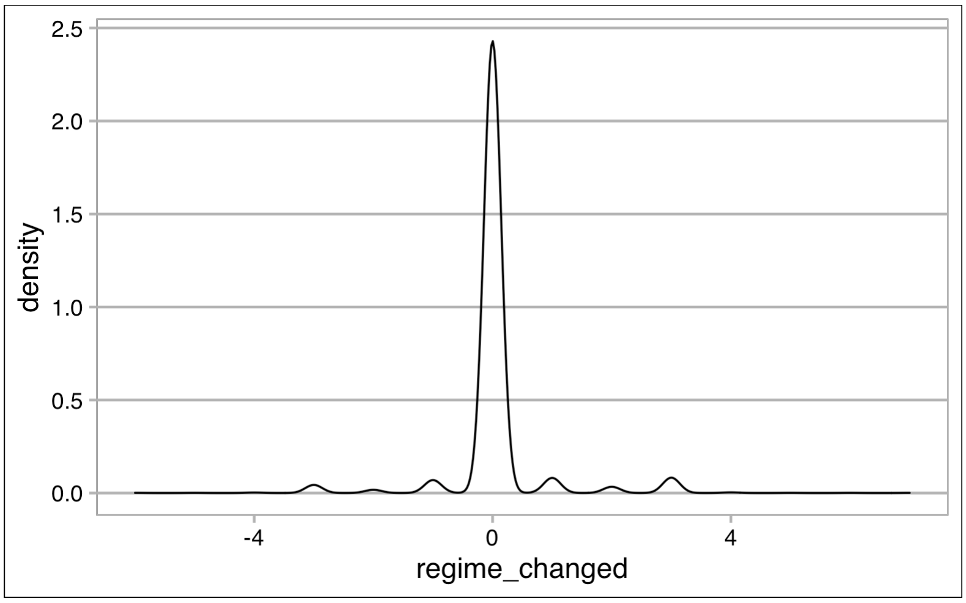
Operationalizing Central Variables
Conflict
Peace
Severity
Duration
Relapse
Regime Type
Continuous
Ordinal
Regime Change

Slide 6
Existing Literature
U-Shaped probability curve
Rebellion where possible, not only where desired
Role of democracies
Political change as a destabilizer
Elections
Ethnic fractionalization & population size
Macroeconomic safeguards
Lootable resources
Geography and topography
African Context: coups and patronage pyramids

Slide 7
Filling the Gaps
Large-n study
Focused on Africa
Bird’s eye view

Slide 8
Hypotheses
 | Conflict Presence | Severity | Duration | Relapse
Closed Autocracy | Decrease | Increase | Decrease | Decrease
Electoral Autocracy | Increase | Largely increase | Increase | Increase
Electoral Democracy | Increase | Moderately increase | Increase | Increase
Liberal Democracy | Decrease | Decrease | Increase | Decrease
Regime Type
Peace
Severity
Duration
Relapse

Slide 9
Methods
4 existing datasets
28 variables
3,064 country-year observations
6 regression models

Slide 10
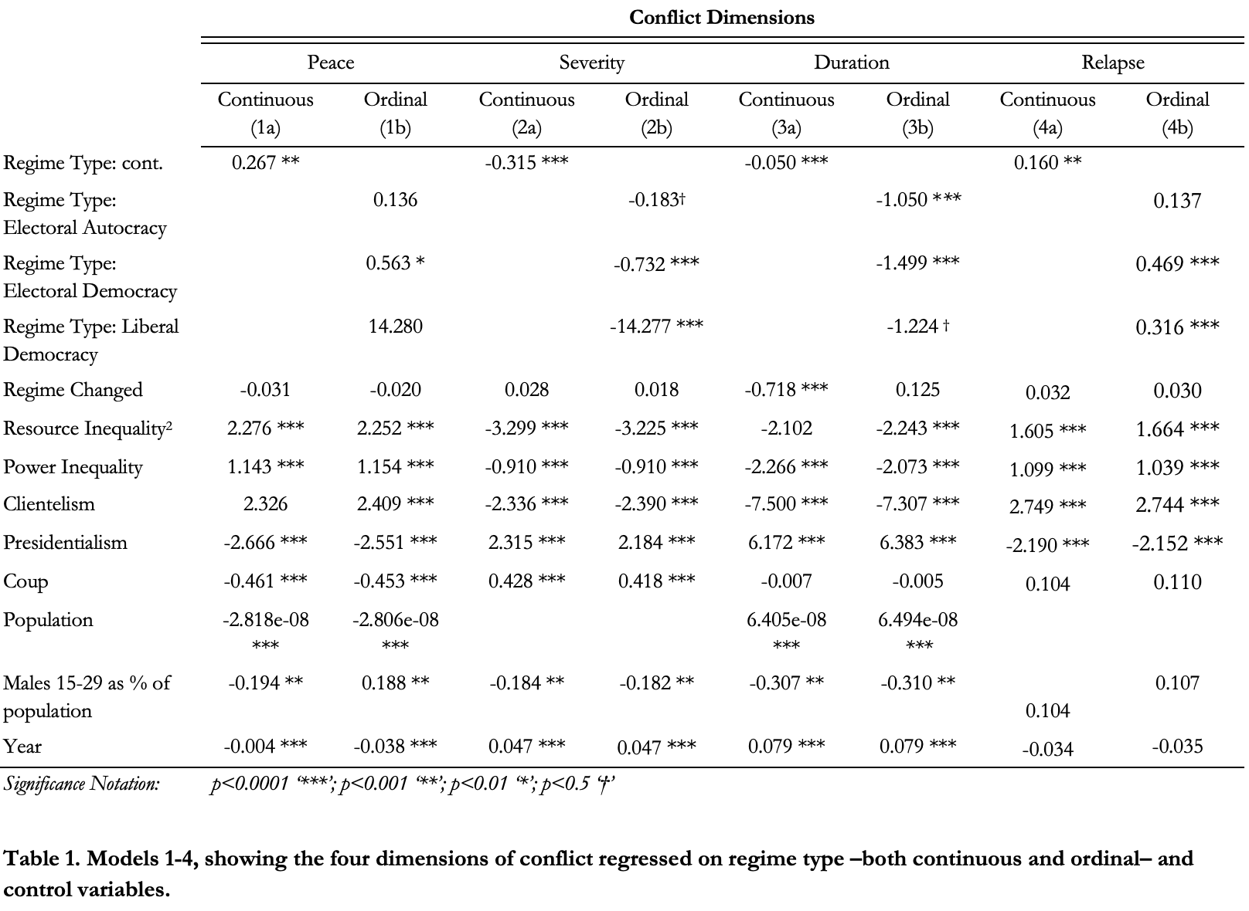
Results

Slide 11
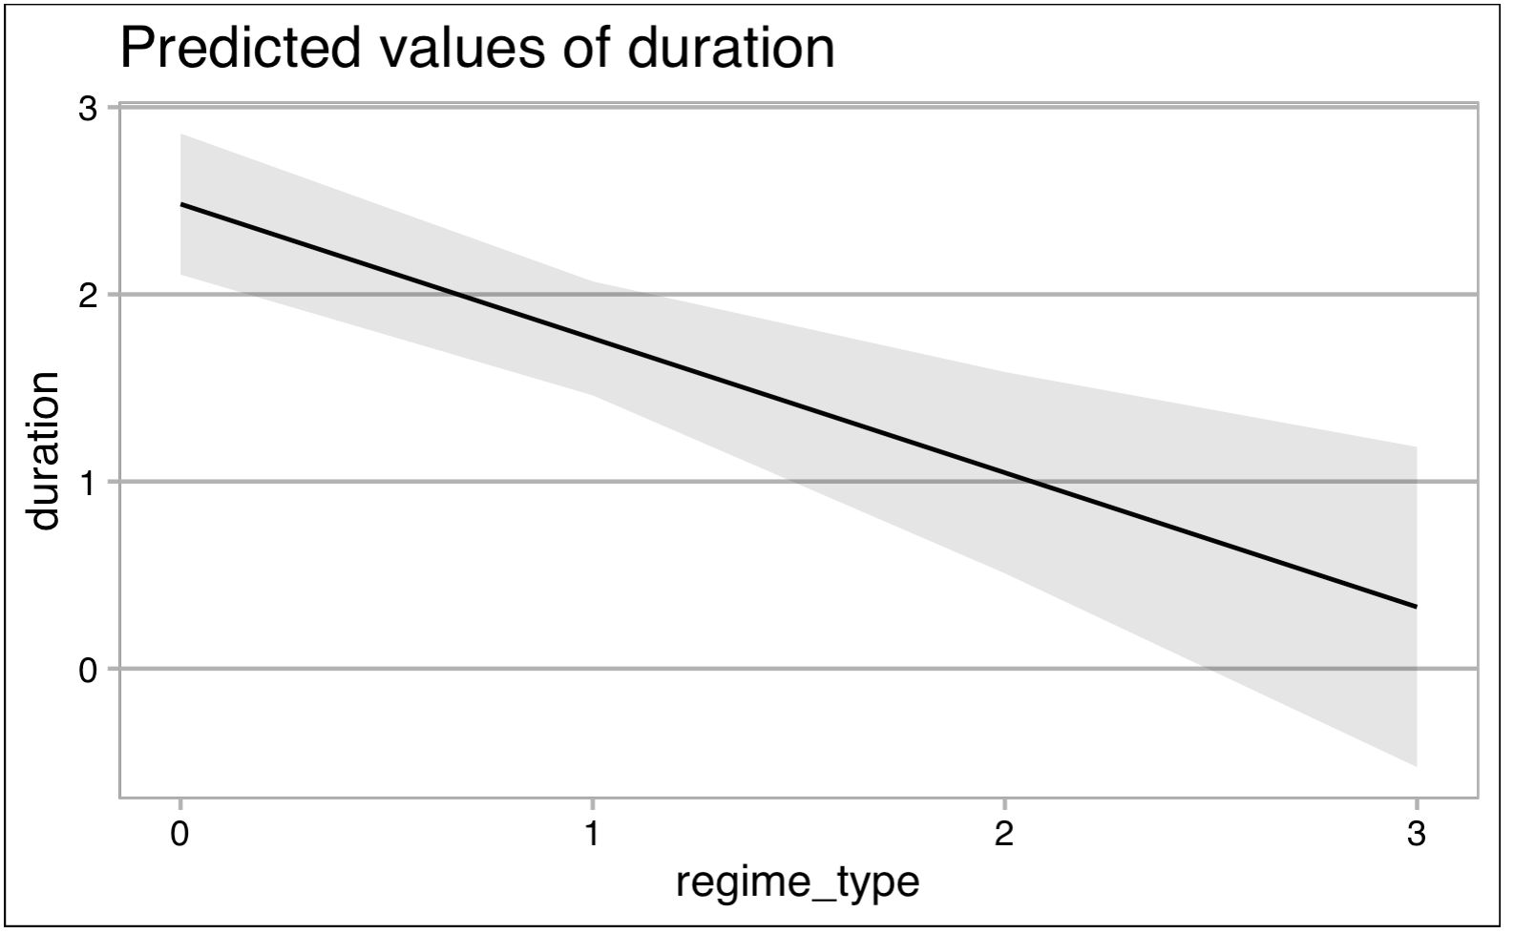
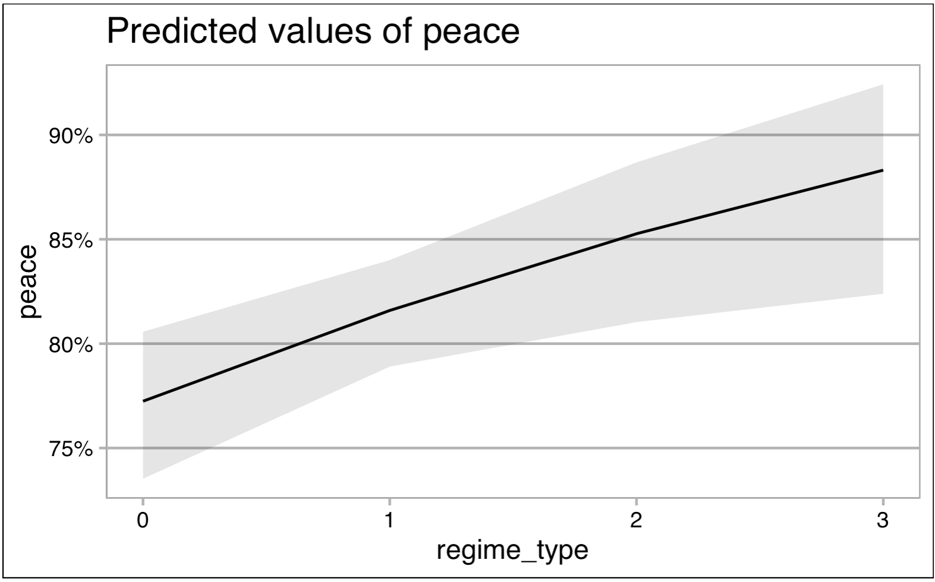
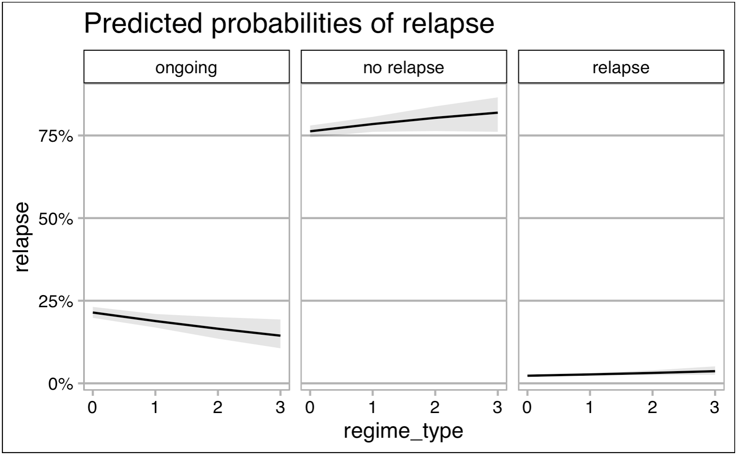
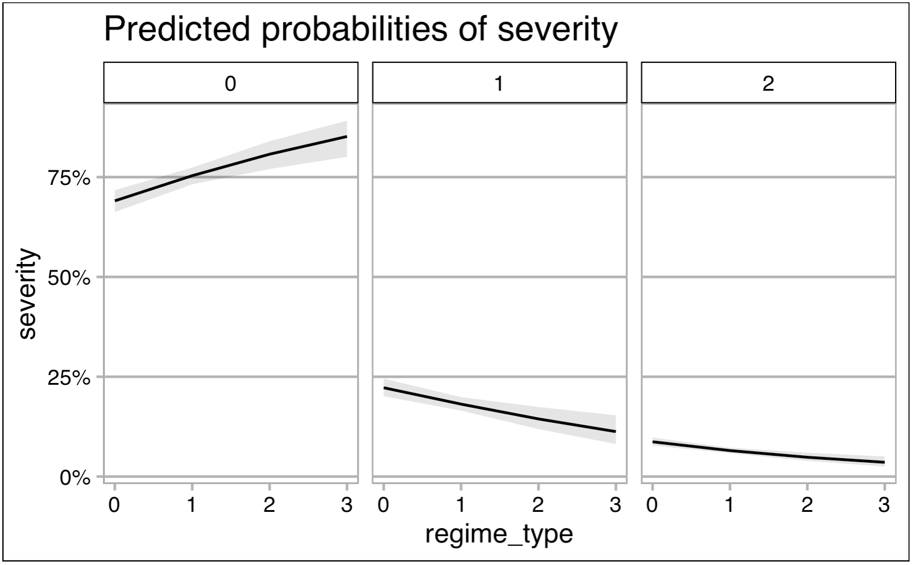

Slide 12
Conclusion
All significant associations for conflict variables
Different directions
Regime type is less influenced by conflict than vice versa
Importance of contextual variables

Slide 13

Questions?

